Slide 2
Original Question
What are differences in quality of living urban vs rural communities?
Examining the quality of life and comparing urban versus rural areas by census block group

Slide 3
Data Sets
Demographic data from the American Community Survey (2016) 5-year estimate on the Census Block Group level (not from the Census API)
All census block group boundaries formatted as a JSON file.
Census attribute tables identified by their Census table ID
Metadata mapping attribute names to a table ID, census block groups to cities and counties, and census block groups to geographic statistics such as percentage land and water.
Google Maps API

Slide 4
Census Block Group versus Zip Codes (ZTCAs)
Census API wrapper allows a for command for all zip codes for the 2016 American Community Survey(
Use the census API and not have to deal with 25 different csv files
Not a ton of other datasets that used Census Block Group
Really specific geographic area
220,000+ locations
Difficult to have sufficient enough data
Zip Code has more opportunity
Using the 2010 Census Survey data, get percentage that a county is urban or rural by zip code.
More data per zip code than census block group

Slide 5
Dataframe from Census API

Slide 6
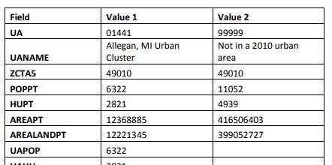
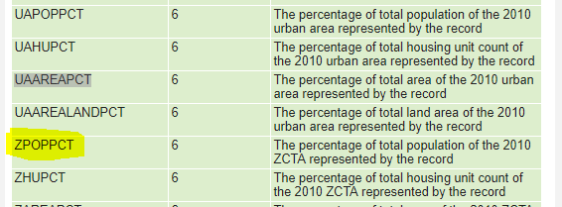
2010 Urban Area to ZIP Code Tabulation Area (ZCTA) Relationship File
Zip codes could have
1 value where 100% urban (just UA)
1 value where 100% rural (just 99999)
2 values where UA and 99999
Or 2 UAs (13 of those)
3-5 values where multiple UAs and maybe an 99999
Filter and countif
46,295 rows
33,140 unique zip codes

Slide 7
Zip Code Merge and Data Cleaning
CSV by zip code with latitude and longitude: 33140
Convert Rural percentage into CSV: 33140
Outer merge confirmed
Census Data has 33120
Outer merge to identify the 20 zip codes
All territories
Also remove instances where the Census Data did not have any population, households, etc.
E.g., large post office may have its own zip code

Slide 8
results

Slide 9
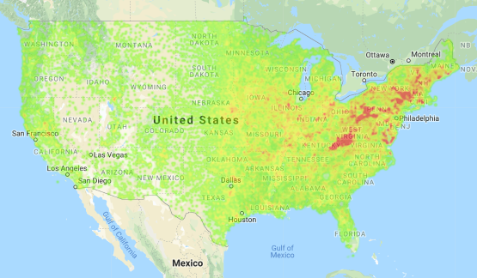
Notes:
Heat Map by Rural Urban percentage…. Rural is red. Shows where we will see data and where we won’t. See the west

Slide 10
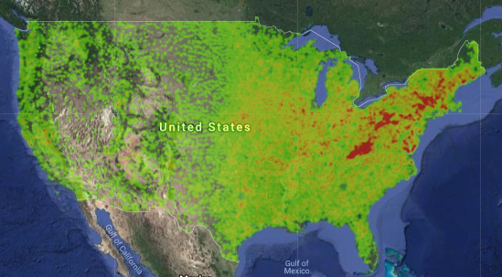
Notes:
Same map but sateliite

Slide 11
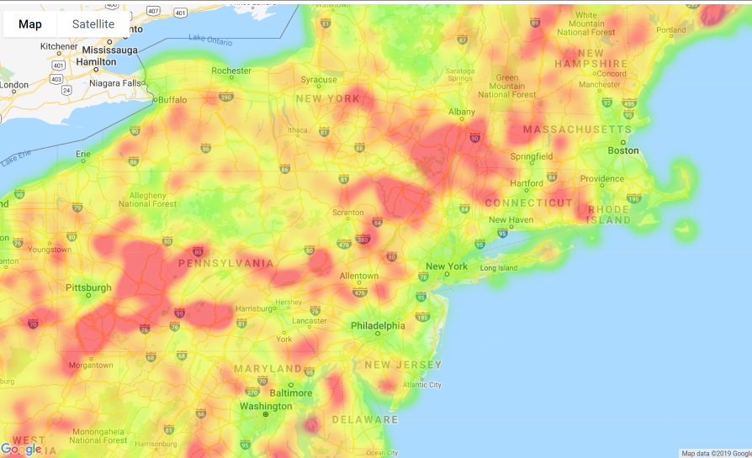
Notes:
Same heat map just zoomed in

Slide 12
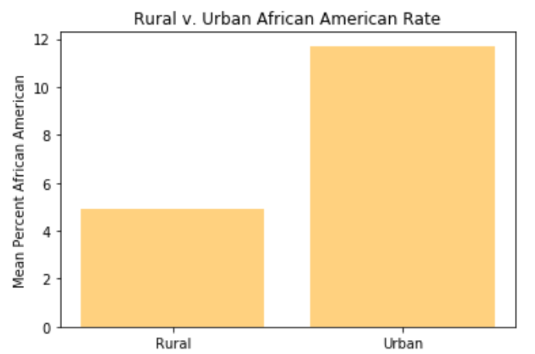
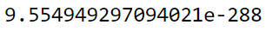
African American: Urban versus Rural
Rural: 4.92%
Urban: 11.71%
T-test:
Notes:
Rural 4.921755 Urban 11.710298

Slide 13
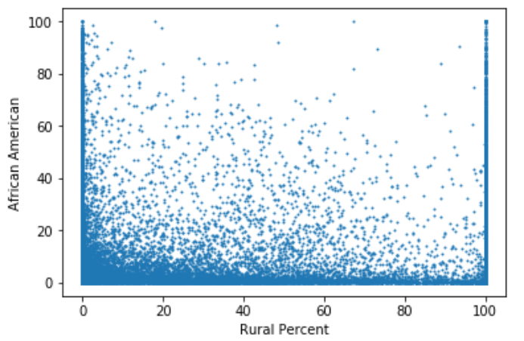
Why we didn’t do scatterplots….

Slide 14
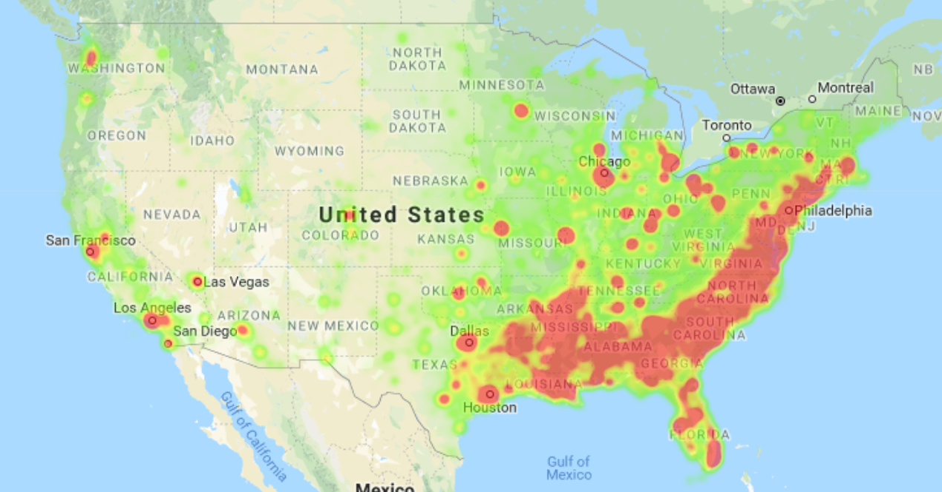
Notes:
Heatmap for African American

Slide 15
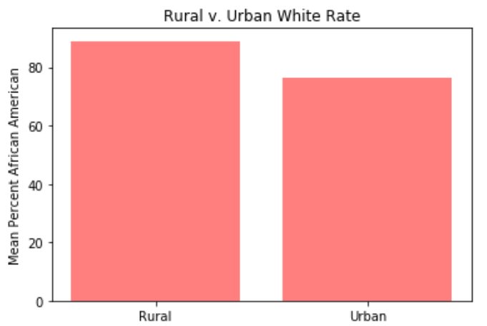
White: Urban versus Rural
Rural 88.951074
Urban 76.190671
significant

Slide 16
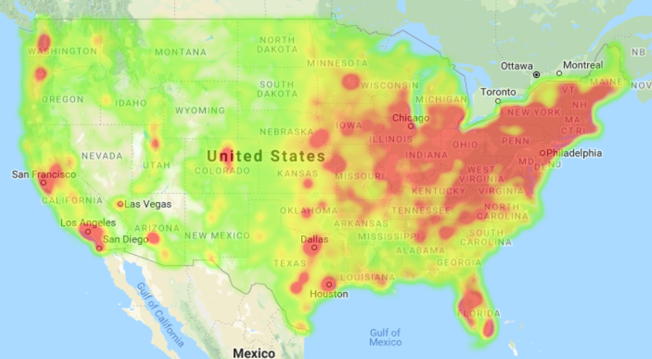

Slide 17
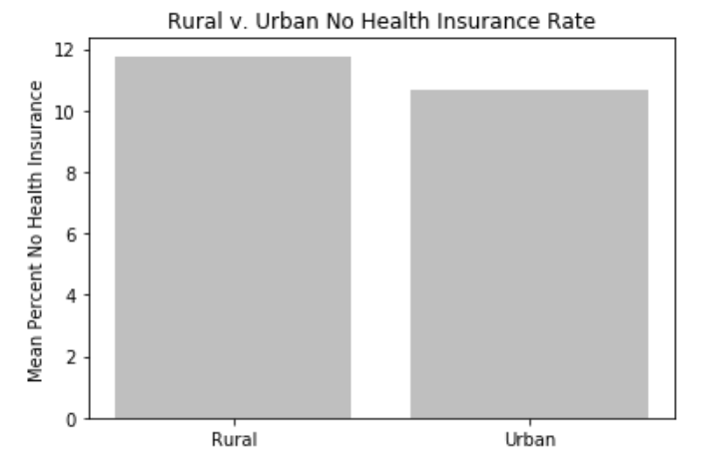
Rural 11.766129
Urban 10.649247
significant

Slide 18
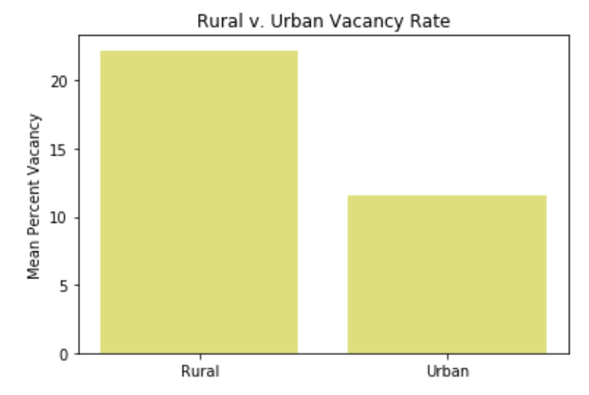
Rural 22.20514
Urban 11.56161
significant

Slide 19
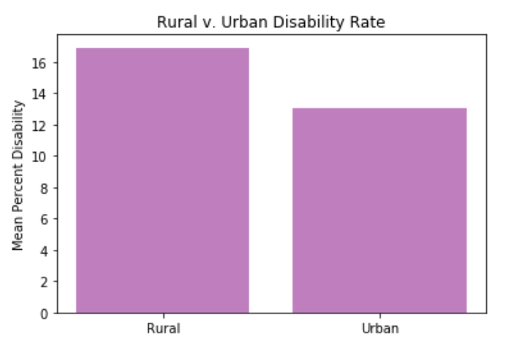
Rural 16.899750
Urban 13.046824
significant

Slide 20
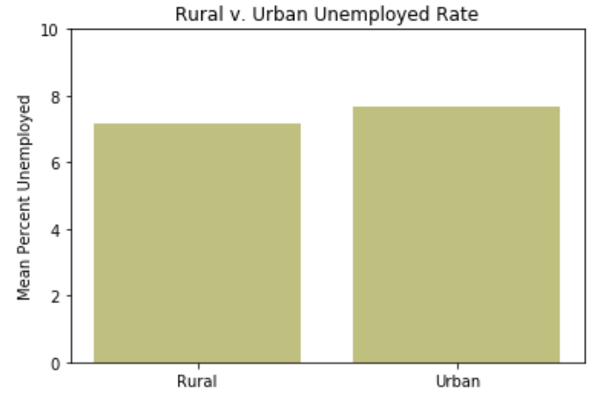
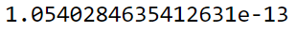
Rural 7.155050
Urban 7.693533
0.54% mean difference still very significant

Slide 21
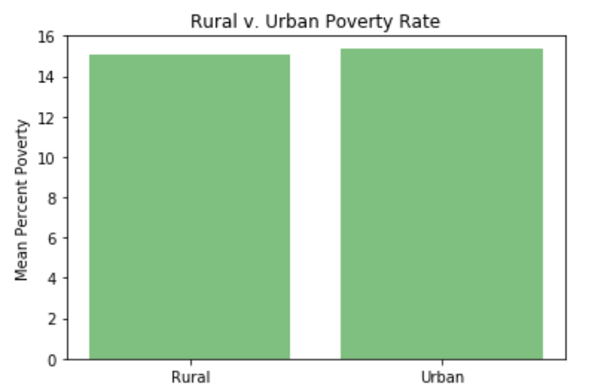
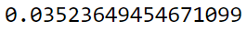
Rural 15.058263
Urban 15.341282
Still significant, if p < .05

Slide 22
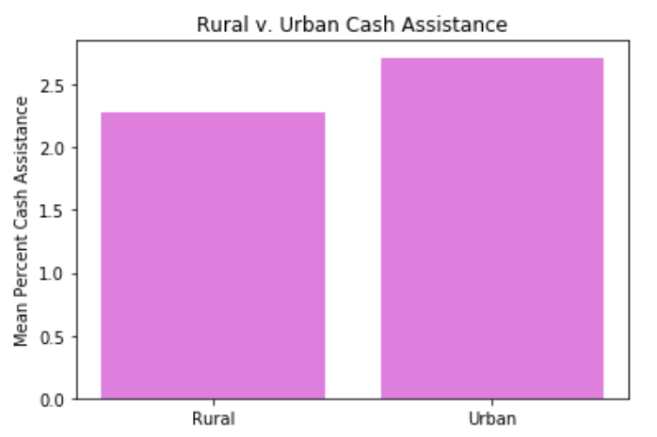
Rural 2.279046
Urban 2.717072
significant

Slide 23
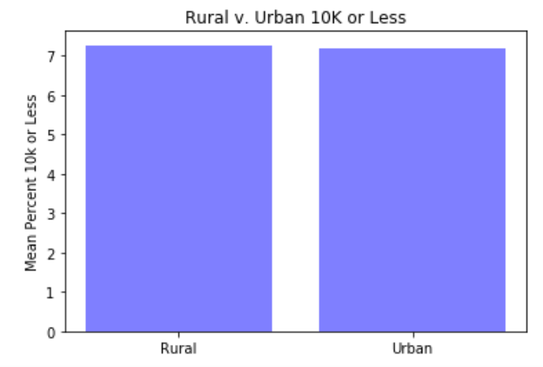
Rural 7.271844
Urban 7.199502
NOT significant

Slide 24
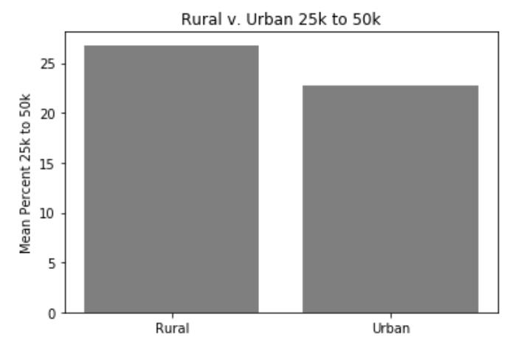
Rural 26.790476
Urban 22.801210
significant

Slide 25
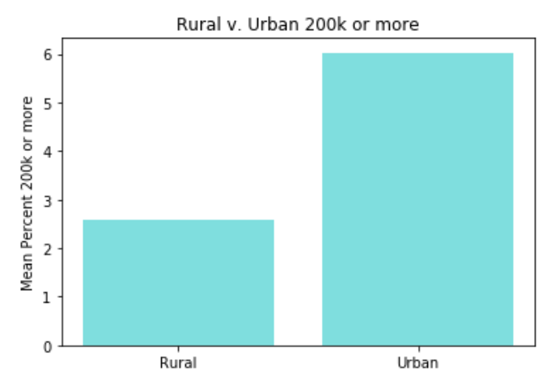
Rural 2.575530
Urban 6.023689
significant

Slide 26
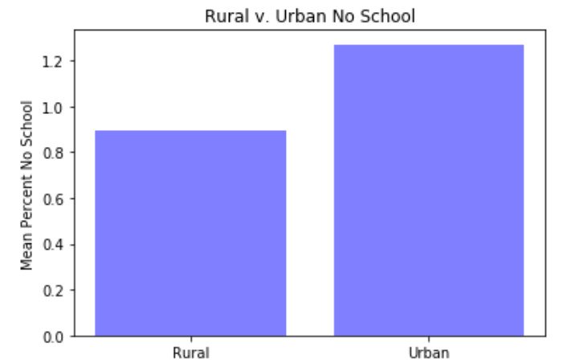
Rural 0.894011
Urban 1.271250
significant

Slide 27
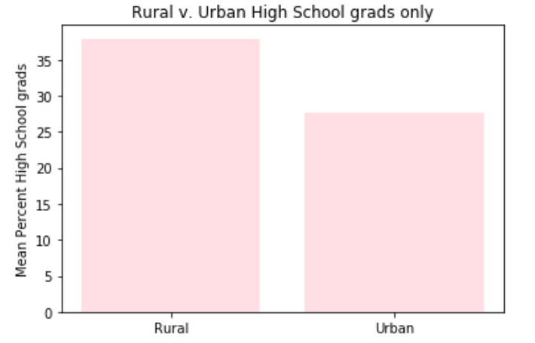
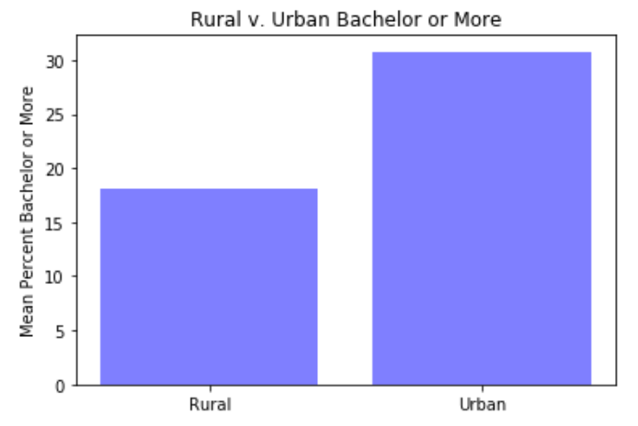
Notes:
High school grads ONLY: Rural 37.941760 Urban 27.706044
Bachelor Population that has a bachelor degree or higher educational attainment
: Rural 18.058370
Urban 30.761606

Slide 28
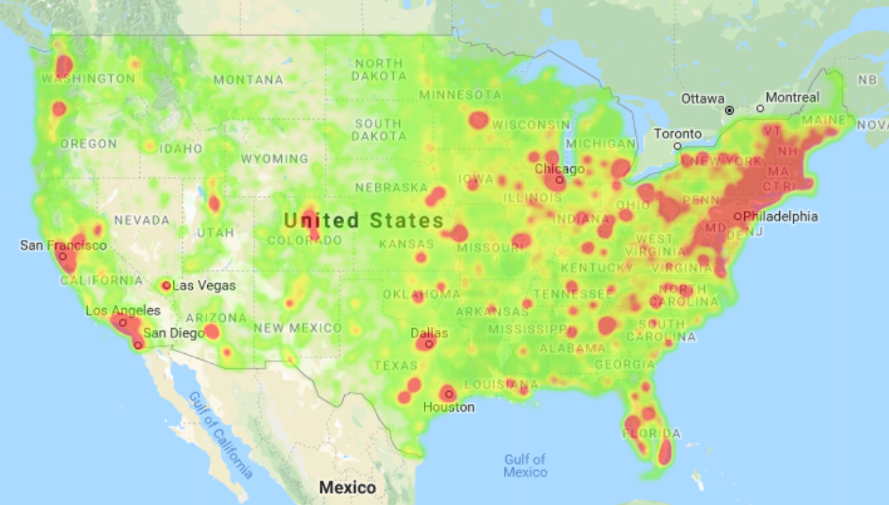
Notes:
Heat map for bachelors and up

Slide 29
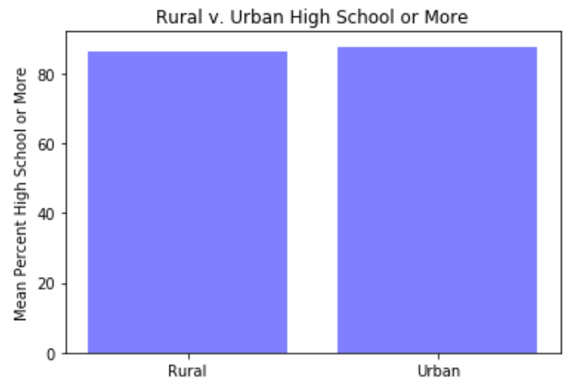
Rural 86.192577
Urban 87.722829
Significant
Population that has a bachelor degree or higher educational attainment

Slide 30
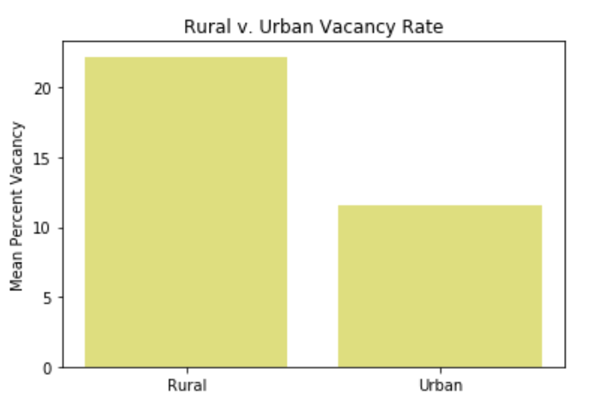
Rural 22.20514
Urban 11.56161
significant

Slide 31
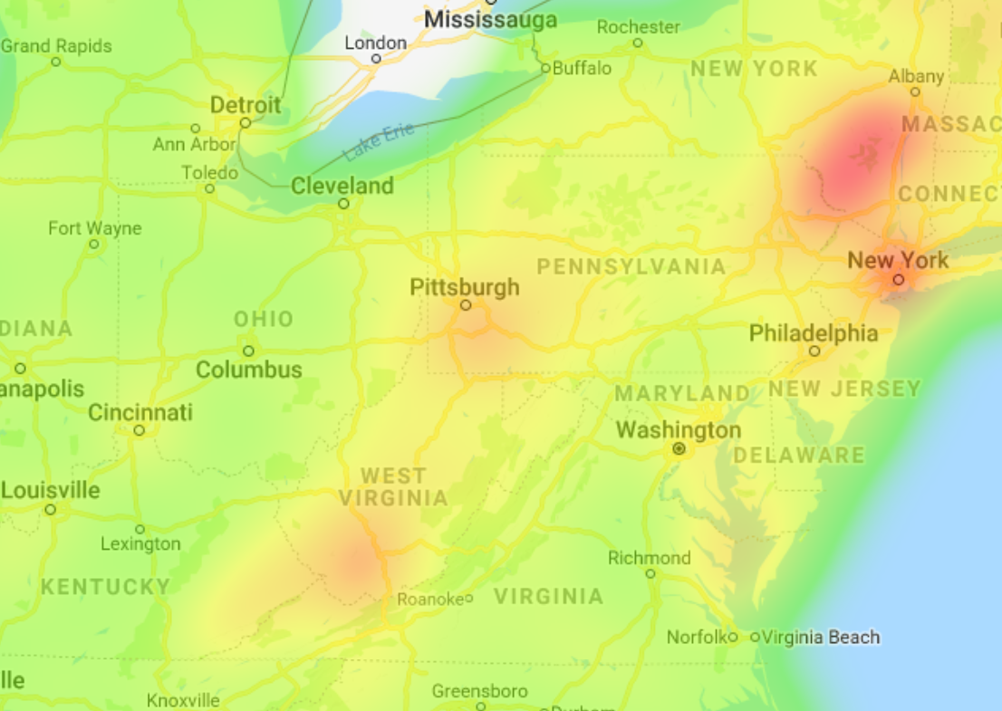
Notes:
Vacancy heat map

Slide 32
Summary
Urban
Higher unemployment
Higher poverty
More cash assistance
Higher income
More education (or not)
Rural
No health insurance
Higher vacancy rate
Higher disability

